Slide 1


Knowledge Discovery from
Natural Language Text
Day 12: Special Data Types
Finding needles in wordstacks
Dr Wei Liu & Tyler Bikaun
Computer Science and Software Engineering
wei.liu@uwa.edu.au
tyler.bikaun@research.uwa.edu.au

Slide 2
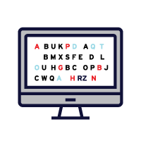

Slide 3
12
Extract text to run ML pipelines over.
Present the practical strategies for using text.
Understand how to handle text.
Understand text preprocessing.
Demonstrate text with supervised and unsupervised learning.

Slide 4
12.0 Overview

Slide 5

12.0 Overview
What is today about?
Knowledge Representation
Machine Learning
Computational Linguistic
Text Mining
Word Embeddings
Topic Modelling
Information Extraction
Sentiment Detection
Dr Wei Liu, UWA

Slide 6
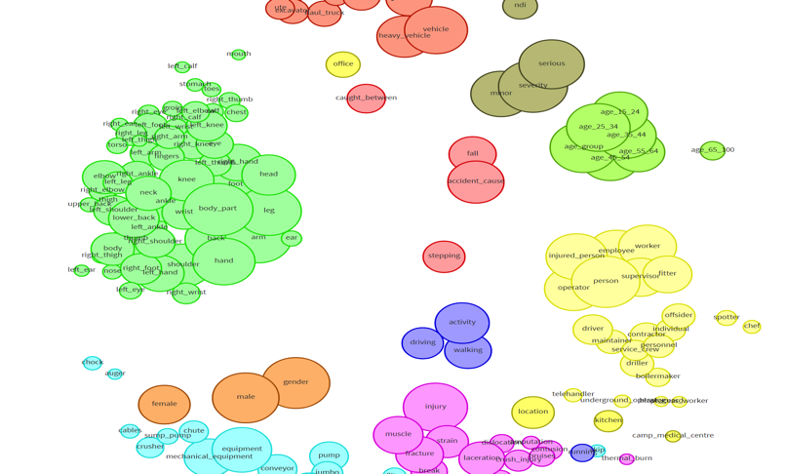
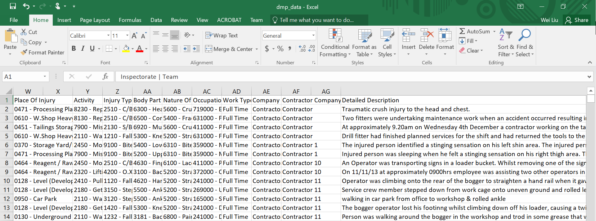
12.0 Overview
Extracting Semantics – Association Rule Mining
Text Mining - http://agent.csse.uwa.edu.au/aquila
Dr Wei Liu, UWA

Slide 7
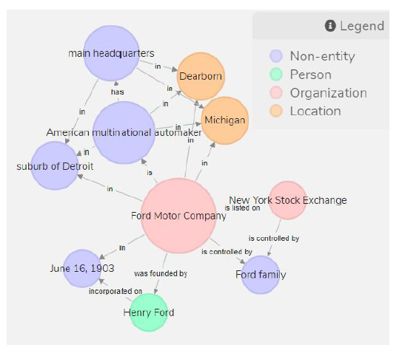
12.0 Overview
Extracting Semantics – Knowledge Graph Construction from Text
Ford Motor Company is an American multinational automaker that has its main headquarters in Dearborn, Michigan, a suburb of Detroit. The company was founded by Henry Ford and incorporated on June 16, 1903. The company is listed on the New York Stock Exchange and it is controlled by the Ford
family.
Knowledge Graph Construction from Text - http://agent.csse.uwa.edu.au/text2kg
Dr Wei Liu, UWA

Slide 8
12.0 Overview
Extracting “Social” Relations between words
Kalgoorlie + iron-ore –gold = ???
Dr Wei Liu, UWA

Slide 9
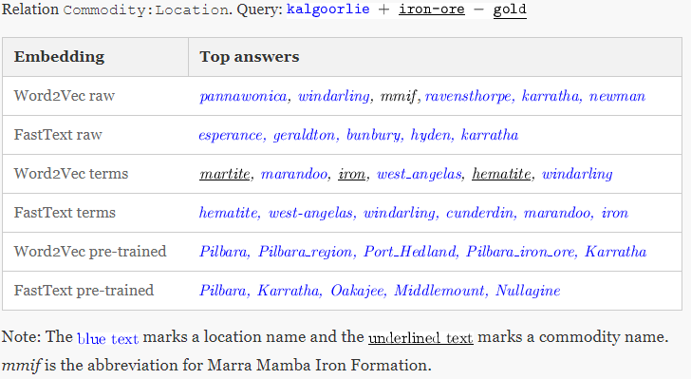
12.0 Overview
Extracting “Social” Relations between words
Dr Wei Liu, UWA

Slide 10
12.0 Overview
Extracting Sentiment from Text
Dr Wei Liu, UWA

Slide 11
12.0 Overview
Extracting Sentiment from Text
Dow Jones
CALM
Johan Bollen, Huina Mao, Xiaojun Zeng. 2011. Twitter mood predicts the stock market,
Journal of Computational Science 2:1, 1-8. 10.1016/j.jocs.2010.12.007.
Dr Wei Liu, UWA

Slide 12
12.1 Text Mining

Slide 13
12.1 Text Mining
Knowledge Representation
Machine Learning
Computational Linguistic
Graphs in knowledge representation
Two different sources
Knowledge experts (logic based)
Knowledge discovery (from natural language texts)
Ontology learning
Entity Extraction
Symbolic
Unsupervised learning
Supervised learning
Subsymbolic
Deep learning
Entity Relation Extraction
Dr Wei Liu, UWA

Slide 14
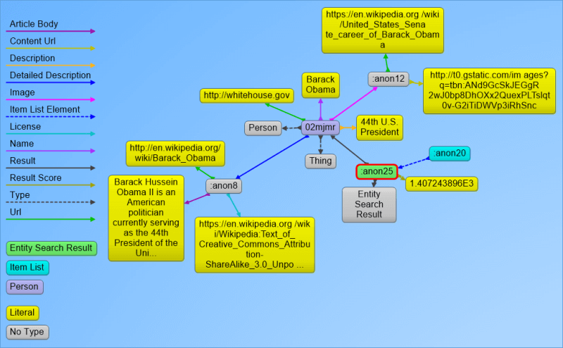
12.1 Text Mining
Knowledge Graph and Linked Data
Used by Google for semantic-enriched information retrieval with a knowledge base gathered from a wide variety of sources, such as Freebase.
Knowledge Graph display was added to Google's search engine in 2012, starting in the United States.
Getting a ranked list of the most notable entities that match certain criteria.
Predictively completing entities in a search box.
Annotating/organizing content using the Knowledge Graph entities.
http://searchengineland.com/laymans-visual-guide-googles-knowledge-graph-search-api-241935
Dr Wei Liu, UWA

Slide 15
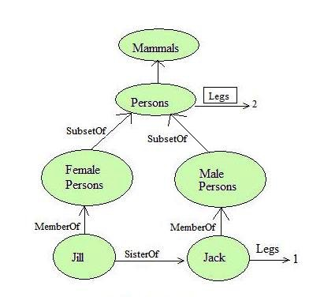
12.1 Text Mining
Semantic Networks (Masterman 1961)
Also known as propositional net.
Representing propositional knowledge.
Mathematically can be defined as a labelled directed graph.
Nodes represent objects such as physical objects, concepts or situations.
Links express the relationships between objects, and link labels specify particular relations.
As nodes are associated with other nodes semantic nets are also referred to as associative nets.
http://intelligence.worldofcomputing.net/knowledge-representation/semantic-nets.html#.WODyYvmGPD4
Dr Wei Liu, UWA

Slide 16
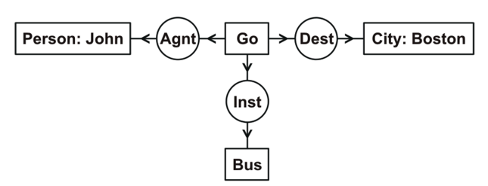
12.1 Text Mining
Conceptual Graph and others (Sowa)
Early graph notations represented the relational structures underlying natural language semantics, but none of them could express full first-order logic.
correlational nets, which were based on 56 different relations, including subtype, instance, part-whole, case relations, kinship relations, and various kinds of attributes (Silvio Ceccato); and
dependency graphs (David Hays), which formalized the notation developed by the linguist Lucien Tesniere (1959).
In the late 1970s, many graph notations were designed to represent first-order logic or a formally defined subset (Findler 1979)
Conceptual Graph* (Sowa 1976) is an intermediate language for mapping natural language questions and assertions to a relational database.
*http://www.jfsowa.com/cg/cg_hbook.pdf
Dr Wei Liu, UWA

Slide 17
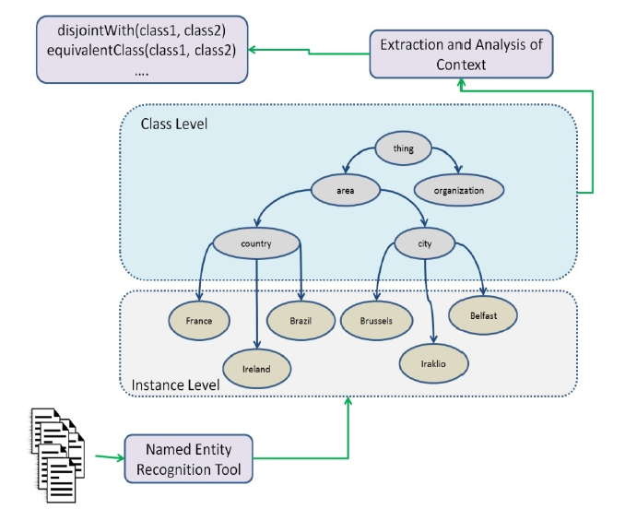
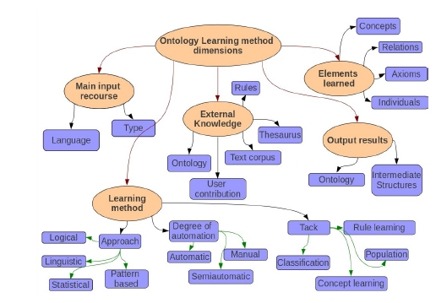
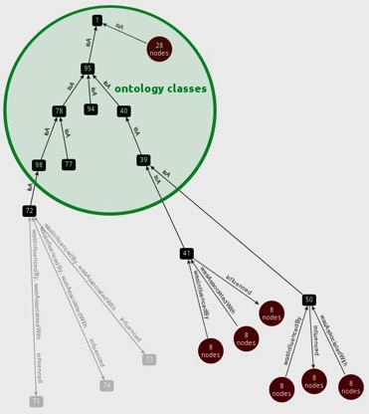
12.1 Text Mining
Conceptual Graph and others (Sowa)
Ana Rios-Alvarado and Ivan Lopez-Arevalo (Technical Report, 2012): Ontology learning from text: Method for learning axioms
Dr Wei Liu, UWA

Slide 18
text > sets of corpora are prepared for ontology construction. Web Crawling is performed to gather web pages from general sources such as Reuters, Discovery and CNet to create the Contrastive Corpus. Readily available non-domain specific
Lightweight Ontologies
texts
term candidates
terms
Text Preprocessing
Text Processing
Term Recognition
Relation Acquisition
parse HTML/XML files for texts.
segment texts to identify sentences.
remove noise.
parse sentences for part-of-speech and grammatical information.
extract noun phrases as term candidates and measure their collocational strength (i.e. unithood).
determine the relevance of term candidates with respect to a domain (i.e. termhood) using text corpora.
acquire semantic relations between terms.
[University of WA]
[education]
[next year]
[Perth]
…
How is [University of WA] related to [education]
...University of WA… universities of Perth...
...[University of WA]…[universities] of [Perth]….
1

Slide 19
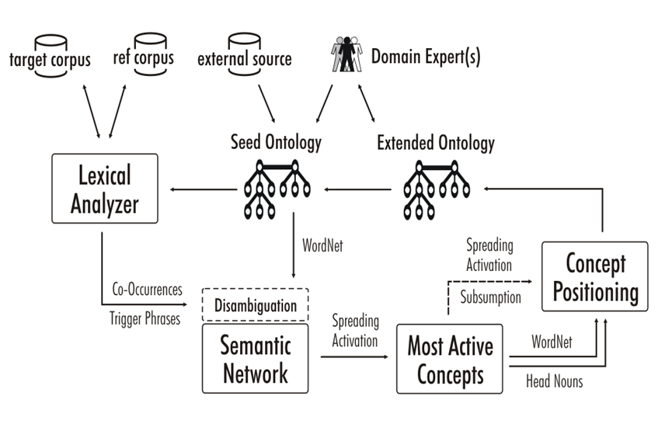
12.1 Text Mining
A semi-automatic ontology learning system
Wei Liu, Arno Scharl & Albert Weischselbraun, 2005
Dr Wei Liu, UWA

Slide 20
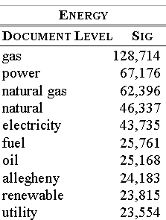
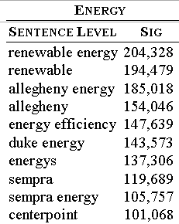
12.1 Text Mining
Results of climate change data analysis
Dr Wei Liu, UWA

Slide 21
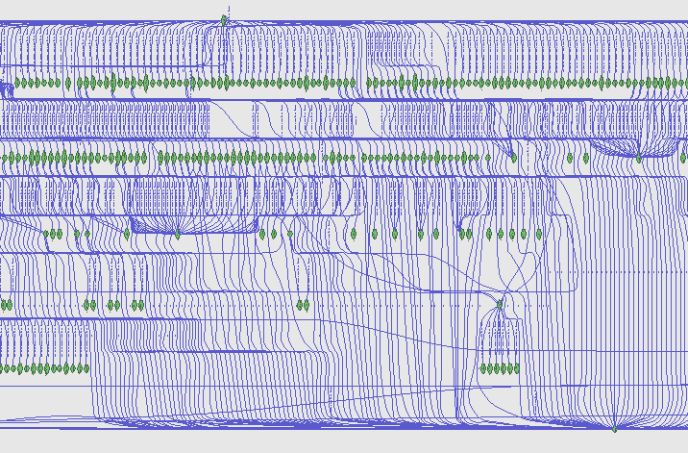
12.1 Text Mining
Semantic Network
Visualisation
Dr Wei Liu, UWA

Slide 22
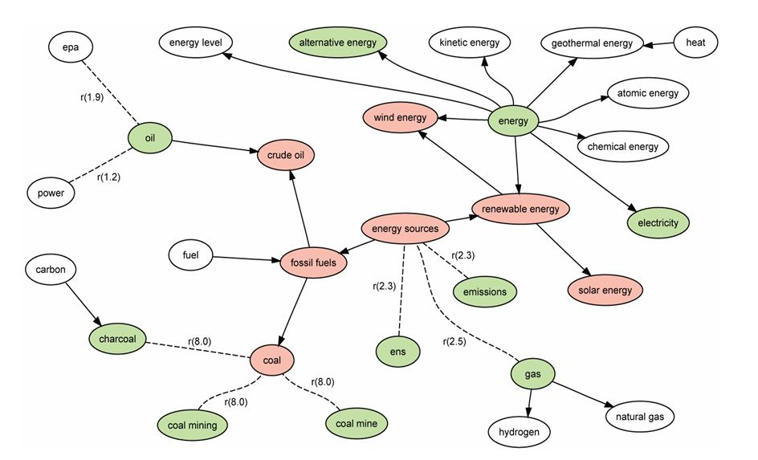
12.1 Text Mining
Spreading Activation
Dr Wei Liu, UWA

Slide 23
12.1 Text Mining
Knowledge Graph Construction From Text
A knowledge graph (KG) is a graph-structured knowledge base that stores knowledge in the form of the relation between entities.
Subtasks of Knowledge Graph Construction
Entity Extraction
Relation Extraction
Axiom Extraction
Note that we do not attempt to link to an existing KG such as Freebase, DBPedia, YAGO, and NELL.
Dr Wei Liu, UWA

Slide 24
text > sets of corpora are prepared for ontology construction. Web Crawling is performed to gather web pages from general sources such as Reuters, Discovery and CNet to create the Contrastive Corpus. Readily available non-domain specific
Lightweight Ontologies
texts
term candidates
terms
Text Preprocessing
Text Processing
Term Recognition
Relation Acquisition
parse HTML/XML files for texts.
segment texts to identify sentences.
remove noise.
parse sentences for part-of-speech and grammatical information.
extract noun phrases as term candidates and measure their collocational strength (i.e. unithood).
determine the relevance of term candidates with respect to a domain (i.e. termhood) using text corpora.
acquire semantic relations between terms.
[University of WA]
[education]
[next year]
[Perth]
…
How is [University of WA] related to [education]
...University of WA… universities of Perth...
...[University of WA]…[universities] of [Perth]….
1

Slide 25
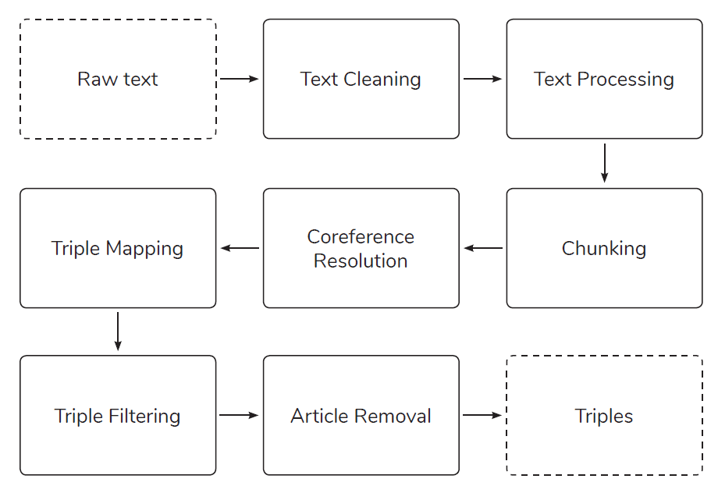
12.1 Text Mining
ICDM Knowledge Graph Contest 2019
M. Stewart, M. Enkhsaikhan and W. Liu, "ICDM 2019 Knowledge Graph Contest: Team UWA," 2019 IEEE International Conference on Data Mining (ICDM), Beijing, China, 2019, pp. 1546-1551.
Dr Wei Liu, UWA

Slide 26
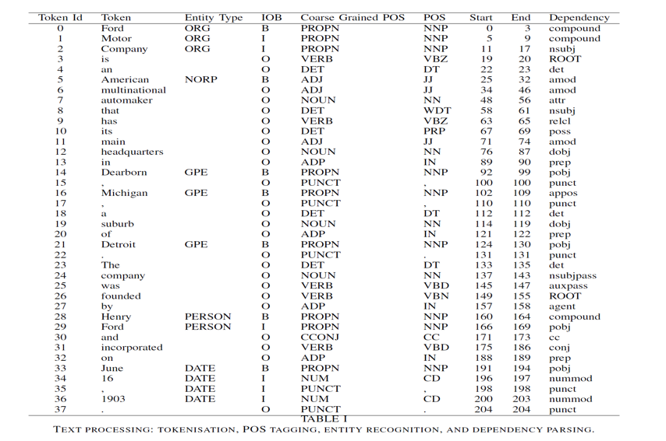
12.1 Text Mining
Text Cleaning and Text Processing
Text Cleaning: special
characters such as hyphen and quotation marks and also break
sentences joined together with no space between them.
Text processing: The text is processed through tokenisation,
POS tagging, entity recognition and dependency parsing
steps using SpaCy.
Dr Wei Liu, UWA

Slide 27
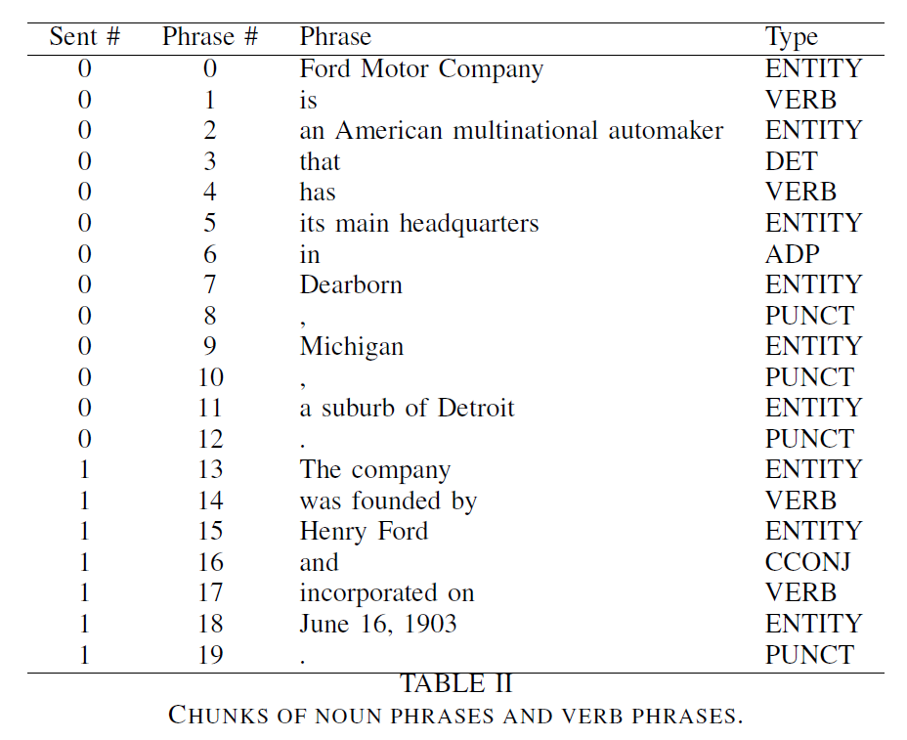
12.1 Text Mining
Phrase Identification – Linguistic Rules
Noun Phrase Chunking:
NP
(NP)
NP + of + NP
NP + NP
Verb Phrase Chunking:
VERB + PART
VERB + ADP
ADP + VERB
PART + VERB11ERB
Dr Wei Liu, UWA

Slide 28
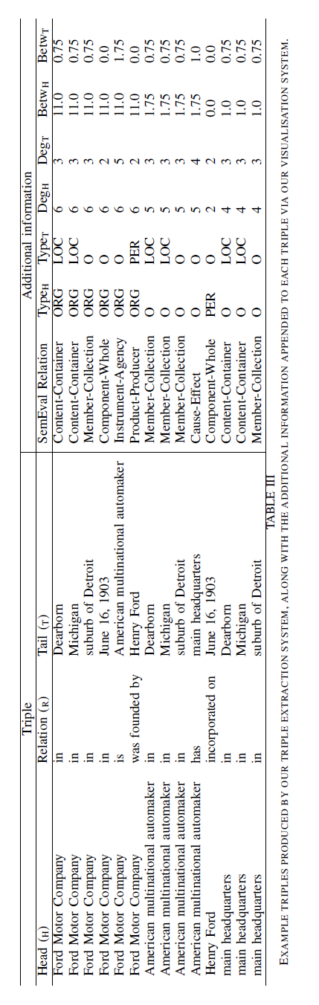
12.1 Text Mining
Triple Creation and Filtering
COREF Resolution *:
Coreference items are resolved by replacing the original phrase with the referred phrase for each item.
Triple Creation: Find triples in the same sentence by finding entities before and after verb phrases;
Document-level triples are obtained by finding shortest path between any pair of entities.
Triple Filtering: remove any triple with a stop word as a head entity. The stop words include NLTK stop words,
names of days (e.g. Monday) and names of months (e.g. January).
Article Removal: articles (a, an, the), possessive pronouns
(e.g., its, their) and demonstrative pronouns (e.g., that, these) are removed from the heads and tails.
NeuralCoref https://github.com/huggingface/neuralcoref

Slide 29
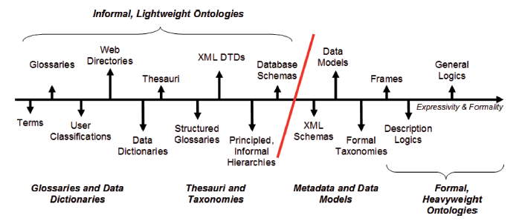

12.1 Text Mining
Overview – What’s Light Weight Ontology
Wilson Wong, Wei Liu, and Mohammed Bennamoun. (2012) Ontology Learning from Text: A look back and into the future, ACM COMPUTING SURVEYS, 44, 4, Article 20, pp. 20:1-20:36
Dr Wei Liu, UWA

Slide 30
12.2 Word Embeddings

Slide 31
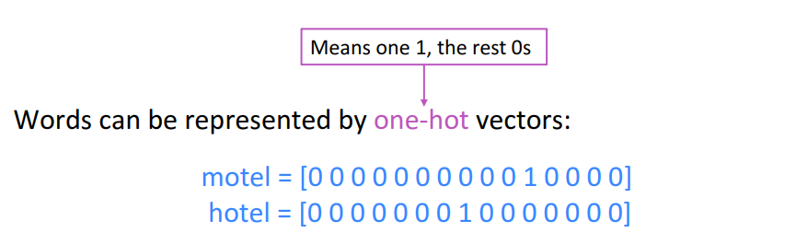
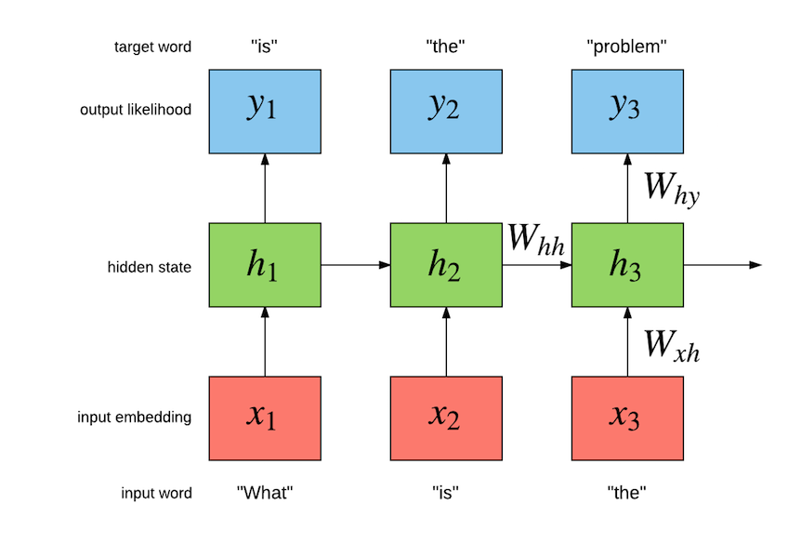
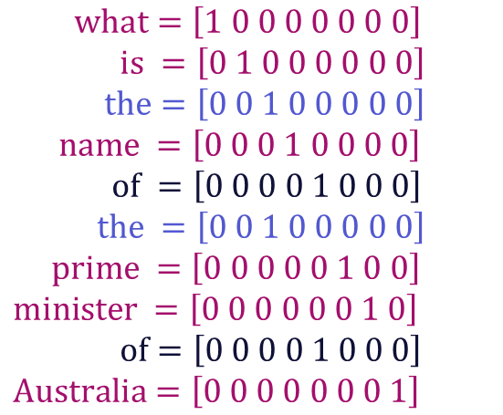
12.2 Word Embeddings
Word representations – one-hot vectors
$$what=\left[1 0 0 0 0 0 0 0\right] \\ is =\left[0 1 0 0 0 0 0 0\right]$$
$$the=\left[0 0 1 0 0 0 0 0\right]$$
$$name =\left[0 0 0 1 0 0 0 0\right]$$
$$of =\left[0 0 0 0 1 0 0 0\right]$$
$$the =\left[0 0 1 0 0 0 0 0\right]$$
$$prime =\left[0 0 0 0 0 1 0 0\right]$$
$$minister =\left[0 0 0 0 0 0 1 0\right]$$
$$of=\left[0 0 0 0 1 0 0 0\right]$$
$$Australia=\left[0 0 0 0 0 0 0 1\right]$$
What is the name of the prime minister of Australia?
(Socher, 2018)
Dr Wei Liu, UWA
Notes:
How do we represent words?
One hot encoding (count vectorising); basic, naïve.
Vector dimension becomes as large as the number of words in the vocabulary. This is not ideal for large ML systems.
Socher, R. (2018, January 18). Natural Language Processing with Deep Learning CS224N/Ling284 [PowerPoint slides]. https://web.stanford.edu/class/archive/cs/cs224n/cs224n.1184/lectures/lecture2.pdf

Slide 32
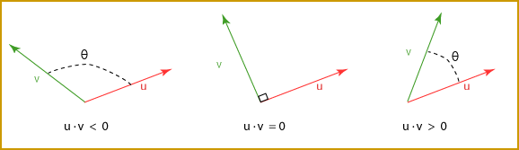
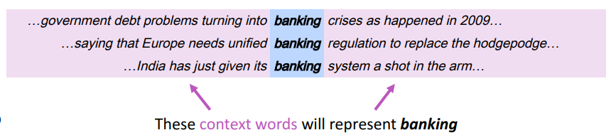
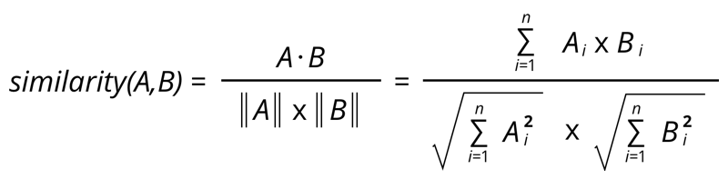
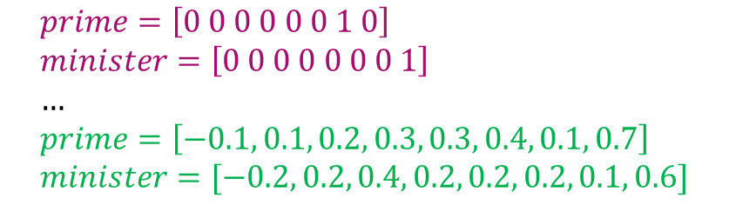
12.2 Word Embeddings
Representing words by their context
One
Hot
$$prime=\left[0 0 0 0 0 0 1 0\right] \\ minister=\left[0 0 0 0 0 0 0 1\right] \\ … \\ prime=\left[−0.1, 0.1, 0.2, 0.3, 0.3, 0.4, 0.1, 0.7\right] \\ minister=[−0.2, 0.2, 0.4, 0.2, 0.2, 0.2, 0.1, 0.6]$$
Word
Embeddings
Dr Wei Liu, UWA
(Socher, 2018)
Notes:
How do we capture semantic and syntactic similarities, relationships with other words, etc.
Concordance
“You shall know a word by the company it keeps” (J. R. Firth 1957: 11)
Distribution representations of words; that is, we want to introduce dependence between words. We are unable to determine similarity between one hot vectors because they’re orthogonal e.g. their dot product is zero.
Socher, R. (2018, January 18). Natural Language Processing with Deep Learning CS224N/Ling284 [PowerPoint slides]. https://web.stanford.edu/class/archive/cs/cs224n/cs224n.1184/lectures/lecture2.pdf

Slide 33
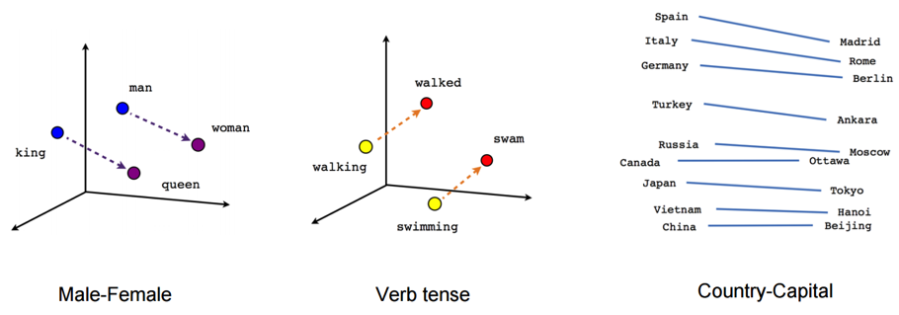
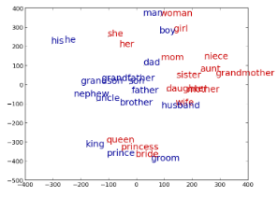

12.2 Word Embeddings
Imagine doing simple math with words
“A is to B as C is to D” tasks
${word}_{A}+{word}_{B}−{word}_{C}≈{word}_{D}$
See: http://rare-technologies.com/word2vec-tutorial/ for word2vec application.
Dr Wei Liu, UWA
Notes:
Word analogies. For example: King – Man + Queen = Female
Similarity -> distance; relationship between words -> angle (the same relationship has the same angle).

Slide 34
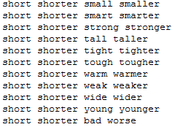
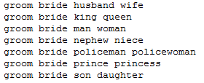
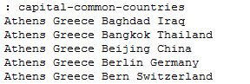
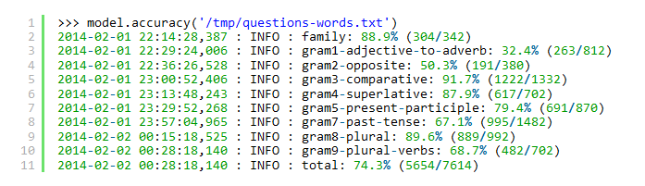
12.2 Word Embeddings
“A is to B as C is to D” tasks
Dr Wei Liu, UWA
Notes:
20,000 syntactic and semantic test examples (Google)
The top 30,000 words ranked according to frequency are used for the evaluation shown.

Slide 35
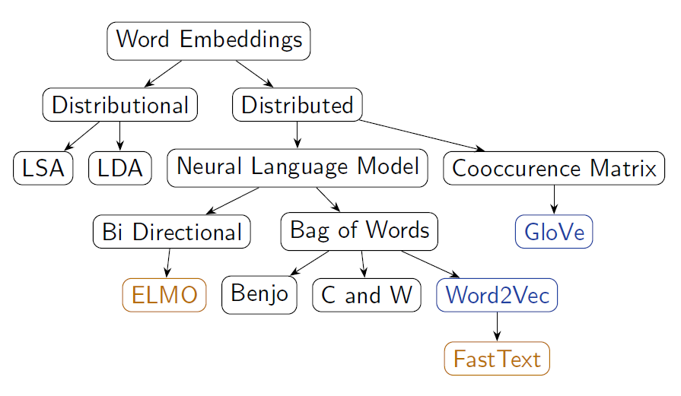
12.2 Word Embeddings
Many ways of obtaining word vectors
Dr Wei Liu, UWA
Notes:
Word2Vec (neural embedding model); ‘self-supervised’
1. one-word context (predicting one word given only one word); referred to as a continuous bag of words (CBOW) model. Input is a onehot encoded vector
2. multi-word context (similar to one-word but we need in multiple words)
3. Skip-gram model (opposite to CBOW multi-word). Given word w predict n words surrounding it (windowing).
GloVe (Global Vectors for Word Representation)-> captures the meaning of a word embedding with the structure of the entire observed corpus. This model utilises word frequencies and co-occurrence counts in a unsupervised manner.
ELMO (Embeddings from Language Models)-> Context-dependent embeddings; uses language models to capture embeddings for individual words while conditioning on the entire sentence or document. Conventional embeddings have issues with polysemy e.g. “the bank on the other end of the street was robbed” vs. “we had a picnic by the bank on the river”. Many embedding models find it difficult to distinguish the difference between the use of the word bank. Elmo captures this meaning by conditioning on the context it’s in and the word vector changes based on the words around it.

Slide 36
12.2 Word Embeddings
Word2Vec (Mikolov et al. 2013)
For learning word representations.
Using a shallow neural network.
No shared parameters across the network.
Fast training – training over Wikipedia snapshot (about 1 billion words) with 50 dimensions takes only 4 hours.
State-of-the-art performance. Learned word embedding vectors can be represented as linear translations, e.g.
Dr Wei Liu, UWA

Slide 37
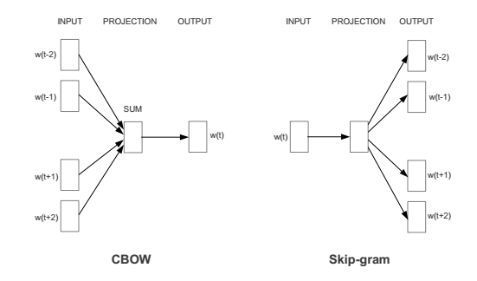
12.2 Word Embeddings
Word2Vec (Cont.)
Word2vec has two models, Continuous Bag of Word (CBOW) and SkipGram models.
CBOW: predicting wt given its context
SkipGram: predicting the context words given a word wt
Demonstration of word2vec models: https://ronxin.github.io/wevi/
Dr Wei Liu, UWA

Slide 38
From Word and Phrases to Sentence Representations
martial [ 0.12657, 0.61425, … , 0.86142]
art [ 0.71089, 0.21725, … , 0.39198]
martial art [ 0.46352, 0.48576, … , 0.09812]
I am learning martial arts [ 0.23242, 0.09824, … , 0.97242]
I am in kongfu training [ 0.21141, 0.08576, … , 0.99812]
I am in kongfu training
I am learning martial arts
army
military
martial
martial art
art
kongfu
craft
Taekwondo
technique
Notes:
X

Slide 39
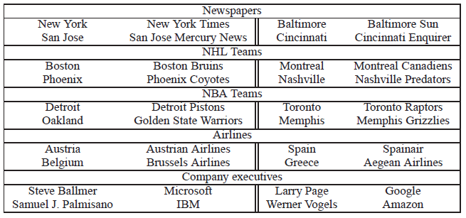
Holistic Approach
Treating phrases in the same way as individual words by using a pre-identified phrase list (Mikolov et al. 2013) .
Using word2vec to train both word and phrase embeddings, achieved 72% accuracy on phrase analogy tests.
Problem:
Suffering from data sparsity, not generating phrases that are not in the pre-identified list or not occur in the training set.

Slide 40
12.3 Topic Modelling

Slide 41
12.3 Topic Modelling
Suppose you have the following set of sentences:
I eat fish and vegetables.
Fish are pets.
My kitten eats fish.
Latent Dirichlet allocation (LDA) is a technique that automatically discovers topics that these documents contain.
bold words under the Topic F, which we might label as “food“.
italics words might be classified under a separate Topic P, which we might label as “pets“
https://www.quora.com/What-is-the-best-way-to-explain-topic-modeling-to-a-layman
Dr Wei Liu, UWA

Slide 42
12.3 Topic Modelling
LDA defines each topic as a bag of words, and you have to label the topics as you deem fit.
We can infer the content spread of each sentence by a word count: Sentence 1: 100% Topic F Sentence 2: 100% Topic P Sentence 3: 33% Topic P and 67% Topic F
We can derive the proportions that each word constitutes in given topics. For example, Topic F might comprise words in the following proportions: 40% eat, 40% fish, 20% vegetables, …
Dr Wei Liu, UWA

Slide 43
12.3 Topic Modelling
3 Steps
LDA defines each topic as a bag of words, and you have to label the topics as you deem fit.
Specify how many latent topics are there
For each word, assign a temporary topic, according to a Dirichlet distribution, e.g. kitten -> F
If a word appears twice, each word may be assigned to different topics.
Function words (e.g. “the”, “and”, “my”) are removed and not assigned to any topics.
topic assignment is updated based on two criteria:
How prevalent is that word across topics?
How prevalent are topics in the document?
Dr Wei Liu, UWA

Slide 44
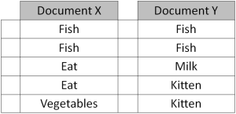
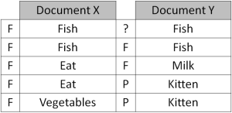
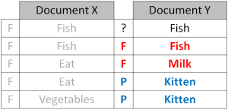
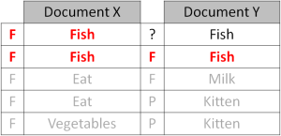
12.3 Topic Modelling
Repeated refinement
The process of checking topic assignment is repeated for each word in every document, cycling through the entire collection of documents multiple times.
This iterative updating is the key feature of LDA that generates a final solution with coherent topics.
Dr Wei Liu, UWA

Slide 45
12.4 Sentiment Detection

Slide 46
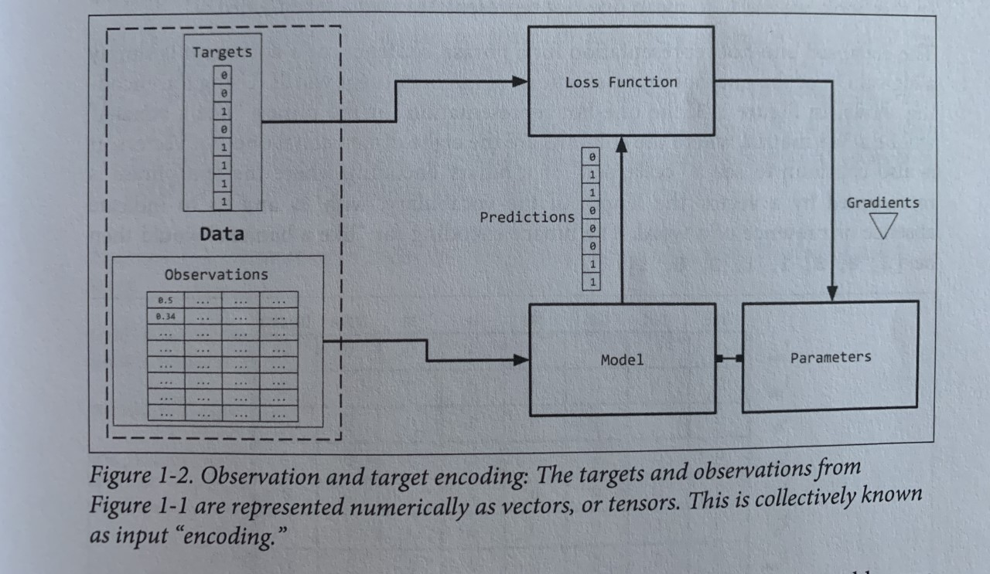
12.4 Supervised Learning
Dr Wei Liu, UWA

Slide 47
12.5 Real-world applications

Slide 48
12.5.1 News article analysis

Slide 49
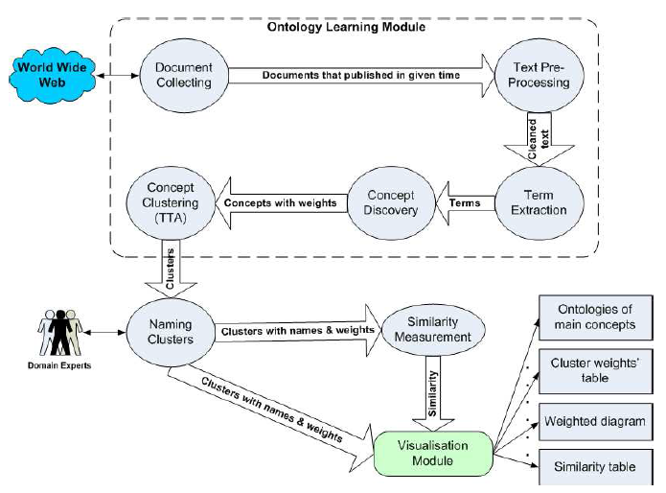

12.5.1 News article analysis
News Topic Evolution
Majigsuren Enkhsaikhan, Wilson Wong, Wei Liu, and Mark Reynolds, 2007
Dr Wei Liu, UWA

Slide 50
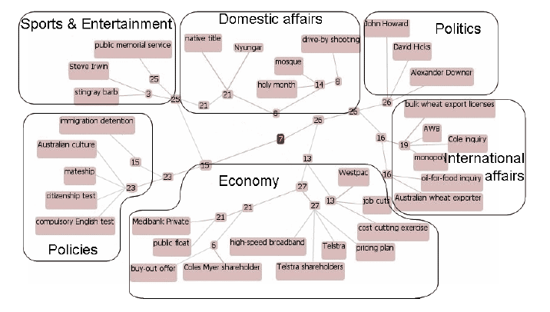
12.5.1 News article analysis
September 2006
Dr Wei Liu, UWA

Slide 51
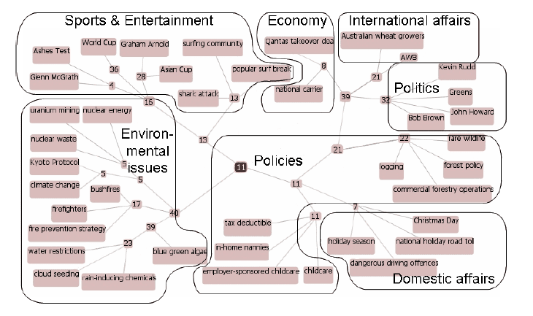
12.5.1 News article analysis
December 2006
Dr Wei Liu, UWA

Slide 52
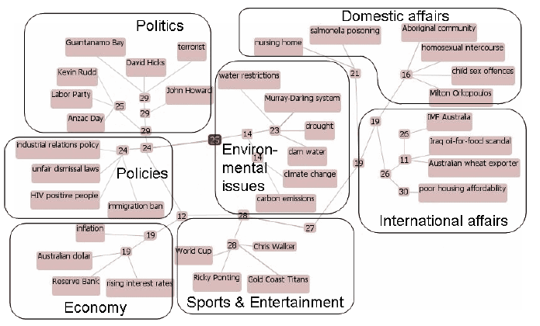
12.5.1 News article analysis
April 2007
Dr Wei Liu, UWA

Slide 53
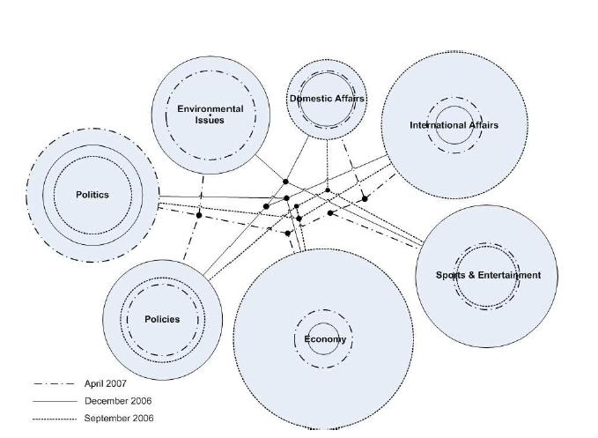
12.5.1 News article analysis
Cluster evolution
Dr Wei Liu, UWA

Slide 54
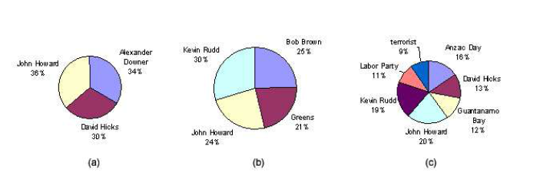
12.5.1 News article analysis
Term frequency distribution
Dr Wei Liu, UWA

Slide 55
12.5.2 Medical diagnosis tool

Slide 56


12.5.2 Medical diagnosis tool
Visualisation
Mobile Application
Mobile App for Medical Self Diagnosis
Graph Construction Procedure
Input Data
Graph Database
Additional Data
Machine Learning
Wei Liu, Harrison Sweeney, Bo Chung, & David Glance. (2014).
Dr Wei Liu, UWA

Slide 57
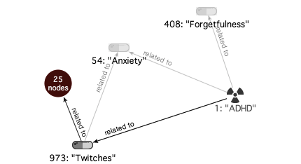
12.5.2 Medical diagnosis tool
Graph Example 1
Dr Wei Liu, UWA

Slide 58
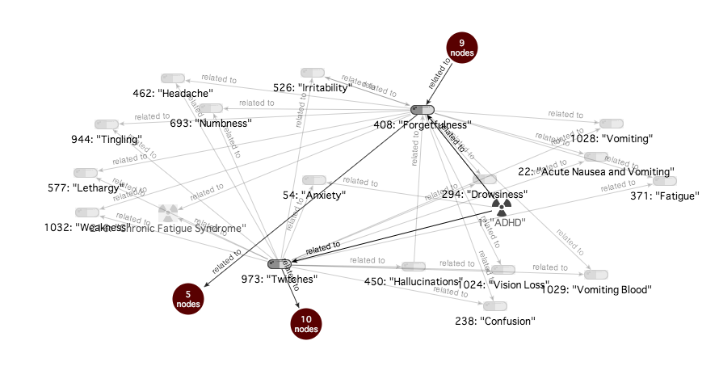
12.5.2 Medical diagnosis tool
Expended Graph
Dr Wei Liu, UWA

Slide 59

12.5.2 Medical diagnosis tool
Further Expansion
Dr Wei Liu, UWA

Slide 60


12.5.2 Medical diagnosis tool
Mobile App
Dr Wei Liu, UWA

Slide 61
12.5.3 Medical term extraction

Slide 62


12.5.3 Medical term extraction
Wei Liu, Bo Chung, Rui Wang, Nigel Morlet and Jonathon Ng, 2015 (under review)

Slide 63
12.5.3 Medical Term Extraction
Medical Term Extraction
An important predecessor step before medical entity recognition, which requires a follow-up step of entity type assignment.
For corpus within a single domain, there is only unit-hood necessary.
Sequence mining technique: PrefixSpan
Hybrid of linguistic and statistical information: CValue
Voting and graph based method: TextRank
Dr Wei Liu, UWA

Slide 64


12.5.3 Medical Term Extraction
Before Filtering (top and bottom 10)
Dr Wei Liu, UWA

Slide 65


12.5.3 Medical Term Extraction
After filtering (top and bottom 10)
Dr Wei Liu, UWA

Slide 66
12.5.4 PUBMED Rank clustering

Slide 67

Author Name Disambiguation PubMed

Slide 68

12.5.4 PUBMED Rank clustering
Author Name Disambiguation PubMed
Arvin Varadharajalu, Wei Liu, Wilson Wong (2011)

Slide 69

12.5.4 PUBMED Rank clustering
NetClus
Yizhou Sun, Yintao Yu, and Jiawei Han. Ranking-based clustering of heterogeneous information networks with star network schema. In Proceedings of the 15th ACM SIGKDD international conference on Knowledge discov- ery and data mining, KDD '09, pages 797-806, New York, NY, USA, 2009. ACM.
Dr Wei Liu, UWA

Slide 70

12.5.4 PUBMED Rank clustering
Dr Wei Liu, UWA

Slide 71

12.5.4 PUBMED Rank clustering
Dr Wei Liu, UWA

Slide 72

12.5.4 PUBMED Rank clustering
Dr Wei Liu, UWA

Slide 73
12.5.5 GSWA survey reports

Slide 74


Part-of-Speech Tagging & Grammar Tree
Report
Stanford Dependency Parser
Grammatically parse sentences in each report
Parts of speech (e.g., nouns, verbs, and adjectives)
Relationships between words (e.g., modifiers, compounds)
Dictionary
Build from a variety of geology related resources
General geology dictionary
Schlumberger oilfields glossary
Other web sources (webpages, databased etc)
Clean extracted terms
Lemmatisation
Noise removal
Noun Phrase Chunker
Summary Graphs & Visualisation
Identify noun phrases
Find complete noun phrases, such as ‘Archean greenstone belt’
Document normalising-splitting sentences-noun phrase identification (using Part-of-Speech pattern)
e.g. <NN.*|JJ>*<NN.*> -- Nouns and Adjectives, terminated with Nouns
Merge grammar tree
Merge compound nouns together, keep modifiers
Provides a visual summary of the report
Page Ranking & Key Noun Phrases
Extract key phrases
Keep phrases if they match our dictionary
Provides key phrase summaries of the report
hole, located, drilling, sequence, work, nickel laterite, mapping, exploration, body, range, bif, potential, period, belt, deposit, terrane, amphibolite, mineralisation, …

Slide 75

12.5.5 GSWA survey reports
Analogy Query: kalgoorlie – gold + iron ore Relation: Location:Commodity
Geological term vectors reflect dedicated information for iron ore (location names in WA, names of iron ores)
martite - a type of iron ore,
marandoo – the Marandoo iron ore mine in the Pilbara region,
hematite - the most important ore of iron,
west angelas - the West Angelas iron ore mine in the Pilbara region,
windarling - Windarling Iron Ore Mine
Pre-trained vectors represent general knowledge
(Middlemount is in Queensland)
Dr Wei Liu, UWA

Slide 76
12.5.6 Maintenance work order processing

Slide 77

12.5.6 Maintenance work order processing
ARC Training Centre for Transforming Maintenance through Data Science
https://www.maintenance.org.au/
Dr Wei Liu, UWA

Slide 78
12.5.7 Redcoat annotation tool

Slide 79


12.5.7 Redcoat Annotation Tool
Text Annotation Tool
http://agent.csse.uwa.edu.au/redcoat
Michael Stewart
Dr Wei Liu, UWA

